Slide 1
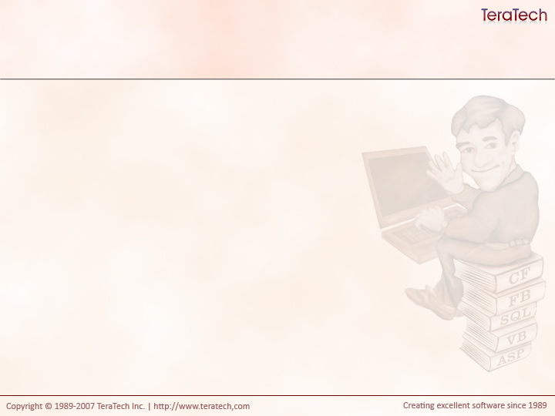
Data Access Design Patterns
Techniques for Success with Data

Slide 2
How do you read data?
cfquery
cffile
cfldap
etc, etc…

Slide 3
Traditional way to Read Data
  <cfquery name="getUsers" datasource="myDSN">
  SELECT *
  FROM Users
  </cfquery>
  <cfoutput query="getUsers">
  <p>#firstName# #lastName#</p>
  </cfoutput>
What’s wrong with this?
  Hard coded DSN
  Query is tied to display logic
    Not reusable
  Mixture of application logic with display logic

Slide 4
Traditional way to Write Data
  <cfquery name="getUsers" datasource="myDSN">
  INSERT INTO User
  (firstname, lastname)
  VALUES
  ("#form.firstname#", "#form.lastname#")
  </cfquery>
What’s wrong with this?
  Hard coded DSN
  Query is tied for form names
    Not reusable
  No query parameters

Slide 5
Common Data Access Actions
Multi-Record Queries
Any sort of ad-hoc query
  SELECT … FROM … WHERE ….
Single Record Queries (Crud)
Create
  INSERT INTO … VALUES …
Read
  SELECT … FROM … WHERE … = X
Update
  UPDATE … SET … WHERE ... = X
Delete
  DELETE FROM … WHERE … = x

Slide 6
Writing Cohesive Components
Which is more cohesive (does one thing well)?
  A component that knows how to read, write, update, delete individual records and knows how to run read multiple rows of data.
  A component that knows how to read, write, update, delete individual records and a second component that knows how to run read multiple rows of data.

Slide 7
Three Common Patterns for Data Access
Beans
  Objects which simply use getters and setters
Table Data Gateways (AKA: Gateways)
  Used to interact with multiple rows of data.
  Typically return queries of data
Data Access Objects (AKA: Daos)
  Know how to persist and read individual objects
  Typically to one object to one record
  CRUD!

Slide 8
Overview of Beans
The term “bean” comes from the Java world
  Aren’t they funny people at Sun?
Beans typically keep all their data private
Control access via getters and setters
Frequently business objects (user, cat, report, whatever)
Can have additional methods to “do” additional stuff.

Slide 9
Overview of Gateways
Very simple
Methods receive arguments and return data
  Typically use cfquery, but we really don’t care.
getTpsReports(fromDate, toDate, userId)
  Returns query

Slide 10
Overview of Data Access Objects
More complex than Gateways.
Methods typically return nothing
  CFCs are passed by reference
create(Bean)
  Uses values in bean to create a new record in database
  Sets generated/id values into bean.
read(Bean)
  Uses id value(s) from bean to record in database
  Populates bean with data
update(Bean)
  Uses values in bean to update record in database
  Identifies record based on id value(s) in bean
delete(Bean)
  Uses id value(s) from bean to delete record in database
Typically resets CFC instance

Slide 11
Configuring These Classes
Typically use a consistent configuration Bean passed in via constructor
Bean has relevant properties:
  datasource
  username
  Password
Notes:
Show the Datasource.cfc and a data access object of some sort

Slide 12
Why the Heck Am I Writing All This Code?! -or- Encapsulation is King!
Testability
  You can easily write unit tests to make sure this code works correctly.
Reusability
  These components can be used by any other code and will always do what they’re supposed to.
Standardization
  Every developer knows where to find queries
  Every developer knows where to put queries
Flexibility
  You can refactor as needed
  So long as your component continues to return the data your application expects, who cares how it’s retrieved?

Slide 13
Exercise Time!
You have 90 minutes
Write unit tests for all your existing components
Write unit tests for the new components you’re about to create (before you write the cfcs!)
Create a Bean to configure datasource settings
Create a Gateway to list categories
Create a Fortune Bean
Create a Fortune Dao
  Add an extra method to read a random fortune based on a category id in your fortune bean.
Update your Fortune CFC to use these new components instead of directly querying for data.

Slide 14
Discussion Time!
What do you get from writing all these data access classes?

